Slide 1
MeHI Overview
and
Digital Health Sandbox Program
ARC Innovation Accelerator
July 15, 2025

Slide 2







Mission:
To strengthen the competitiveness of the tech and innovation economy by driving strategic investments, partnerships and insights, that harness the talent of Massachusetts.
Divisions:
The Massachusetts Technology Collaborative (MassTech) was established in 1982 by legislative statute.

Slide 3
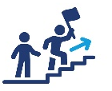
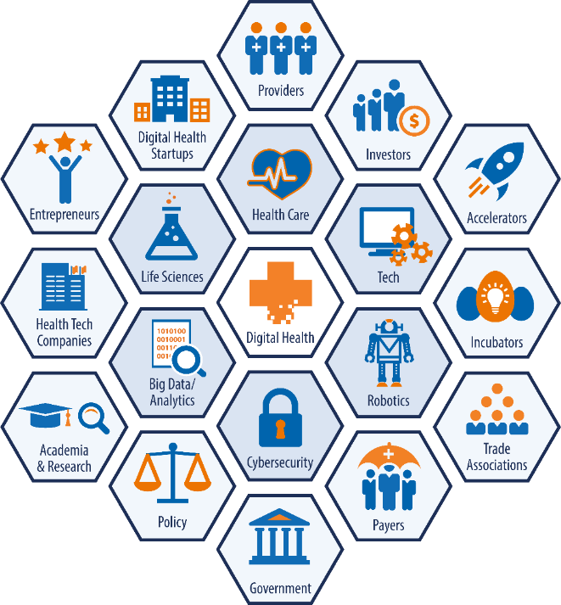
Massachusetts eHealth Institute
MeHI is the designated state agency for growing the digital health ecosystem in Massachusetts
Purpose
Supporting Innovations in Digital Health
We catalyze healthcare innovation, technology, and competitiveness, and accelerate the adoption and utilization of health technologies across provider settings to increase access to the safe, efficient and high-quality healthcare in Massachusetts.
Digital Health Sandbox Program
Accelerates digital health companies on their growth path by leveraging the knowledge base of MA R&D organizations
Healthcare Challenge Funding Opportunities
Rolling Grants for Massachusetts based startups
Digital Health Events to bring stakeholders together
Trusted Partner to EOHHS through Mass HIway Contract
Under contract with HHS, MeHI provides subject matter expertise, policy guidance, project management and operational support to EOHHS for their statewide health information exchange.
Workforce Development
Health IT Mentorship Program
Monthly Cybersecurity Trainings for Healthcare Community in partnership with MassCyberCenter
Jobs Boards focused on Digital Health and Health IT career opportunities

Slide 4
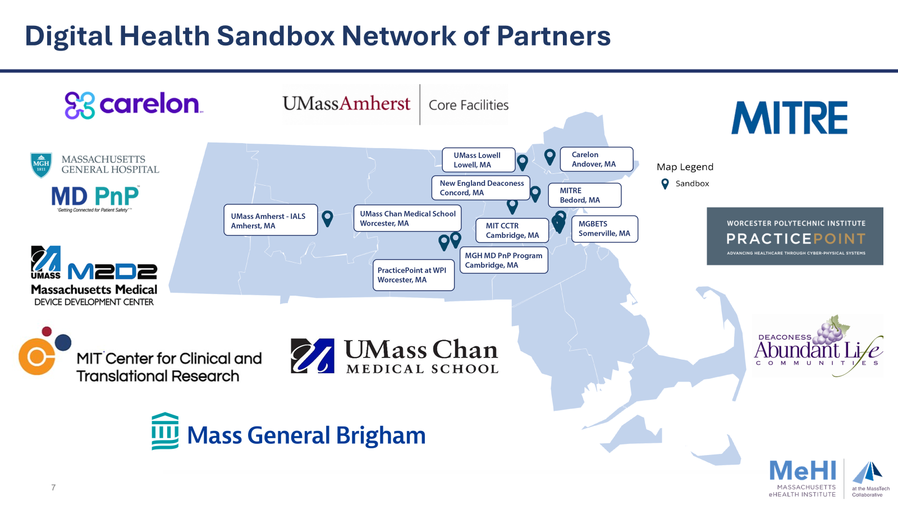
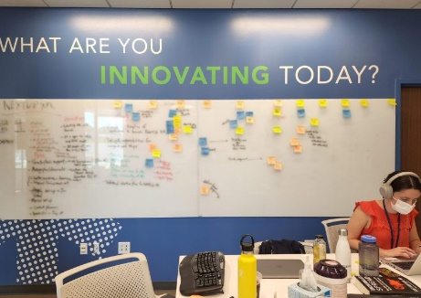
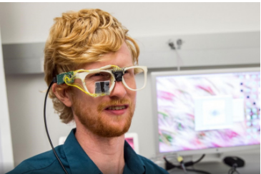
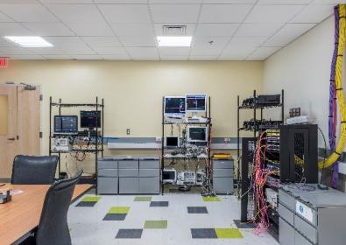
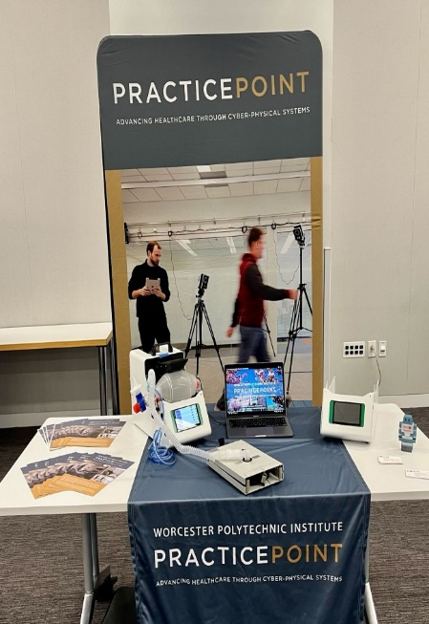
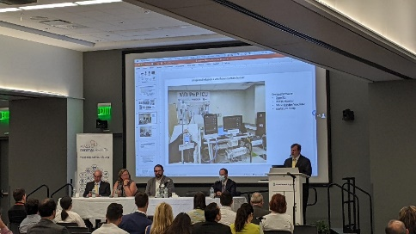
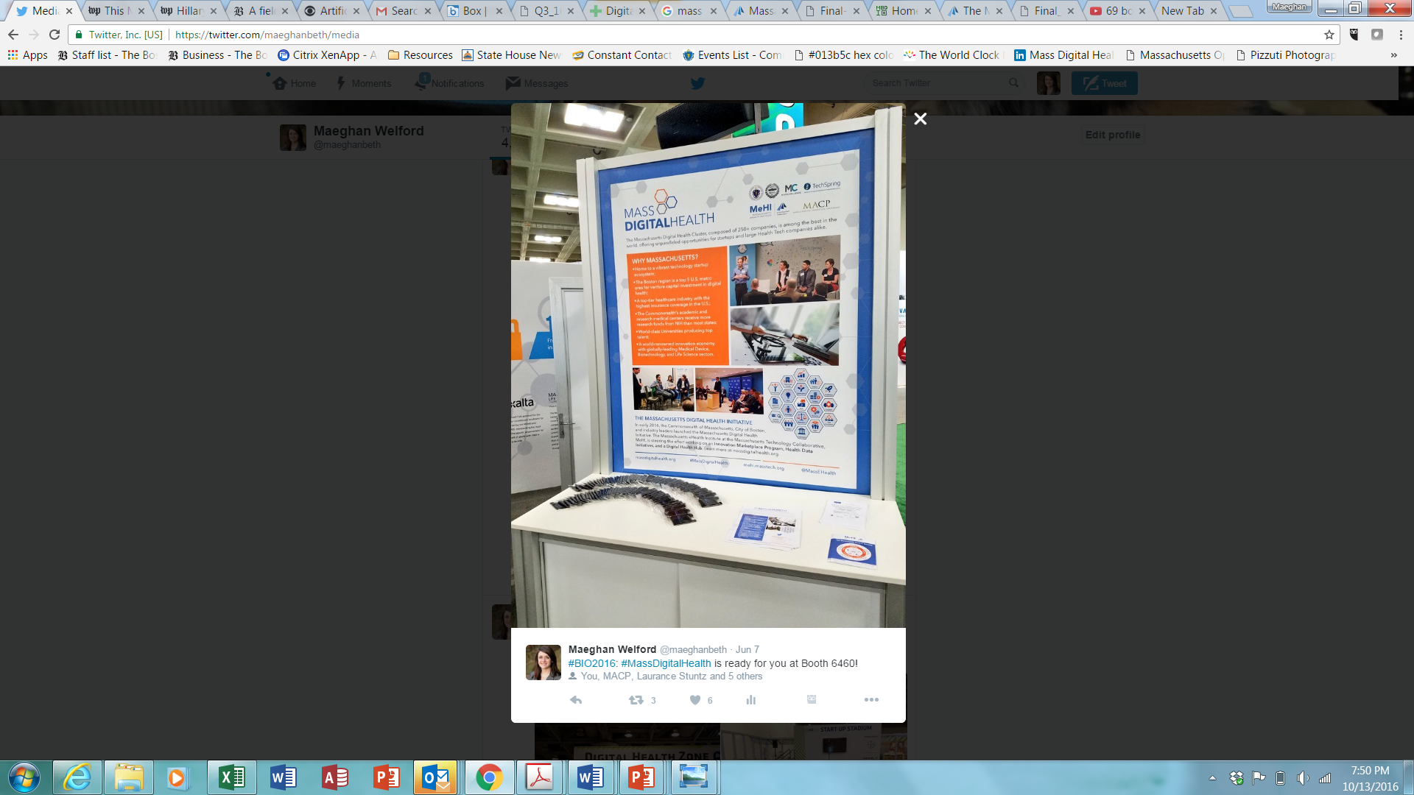
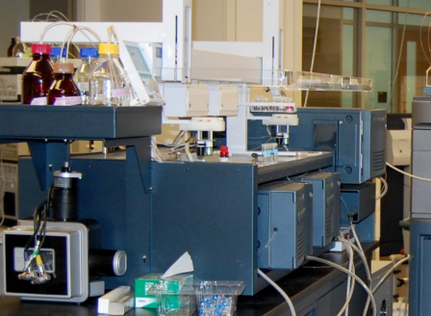
Digital Health Sandbox Program
The Digital Health Sandbox Program accelerates digital health companies on their growth path and expands the knowledge base of MA R&D organizations by:
Establishing a vetted network of Sandboxes that leverage their existing experience and expertise to support product development
Engaging with digital health companies and matching them with Sandboxes that have the specific capabilities to meet their needs
Providing funding for promising validation projects through our Challenge and Rolling grants
Promoting best practice sharing among Sandbox partners to optimize the value of the Network and promote the strength of the digital health ecosystem in MA

Slide 5
Digital Health Sandbox Program
The Digital Health Sandbox Program accelerates digital health companies on their growth path and expands the knowledge base of MA R&D organizations by:
Establishing a vetted network of Sandboxes that leverage their existing experience and expertise to support product development
Engaging with digital health companies and matching them with Sandboxes that have the specific capabilities to meet their needs
Providing funding for promising validation projects through our Challenge and Rolling grants
Promoting best practice sharing among Sandbox partners to optimize the value of the Network and promote the strength of the digital health ecosystem in MA

Slide 6



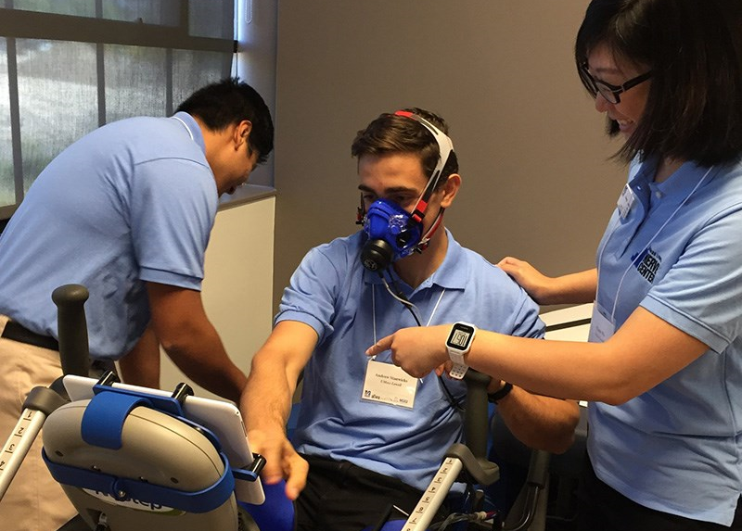












Sandbox Resources
Pilot Partners
User Experience Testing
Focus Groups
These Sandboxes provide access to clinical and non-clinical staff, patients, health plan members, senior living residents, family caregivers, and others to conduct small pilots in clinical and simulated settings.
These Sandboxes support the design and execution of user experience testing. They can also help recruit relevant participants and conduct testing in real and simulated settings.
These Sandboxes can design, organize, and run focus groups to give feedback on digital health solutions. Focus groups may include providers, administrators, IT or cybersecurity staff, payers, patients, senior living residents, family caregivers, and more.

Slide 7
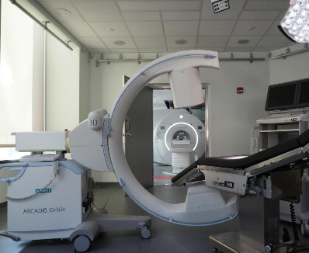

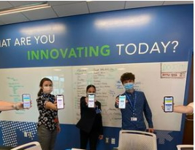
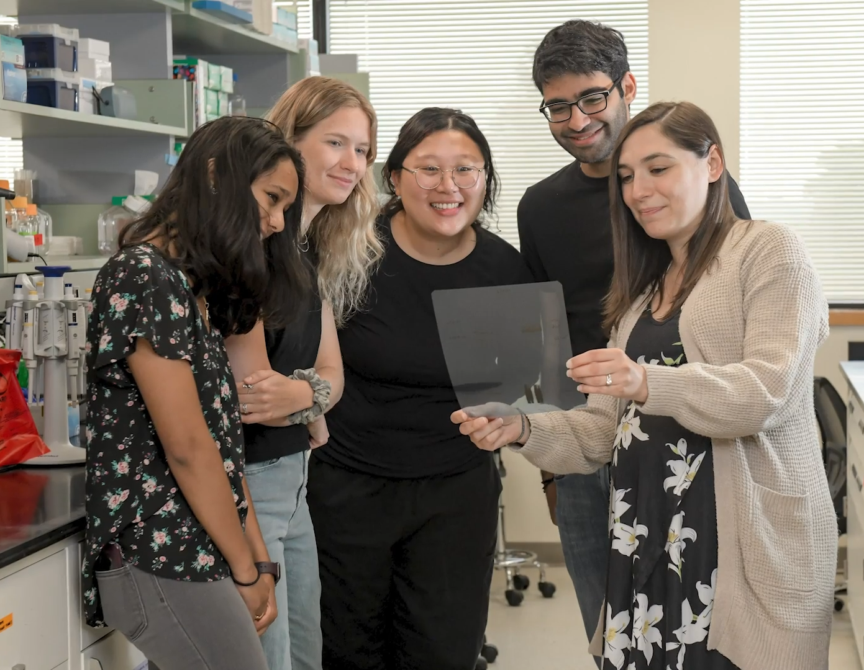








Sandbox Resources
Lab Environments
Research Partners
Reimbursement SMEs
These Sandboxes provide access to cutting-edge laboratory and medical equipment and simulated healthcare settings for research and testing. They can also provide guidance to design and conduct testing in their environments.
These Sandboxes provide access to experts to design and support the implementation of research projects, including focus groups, pilots, and clinical trials. They may also serve as research partners or advisors in applying for federal grant opportunities.
These Sandboxes provide access to subject matter experts in the health insurance industry to provide consultation, feedback, and recommendations on reimbursement models, contracting, insurance products, and privacy/security needs.

Slide 8

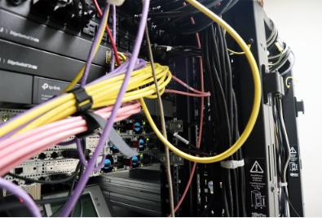

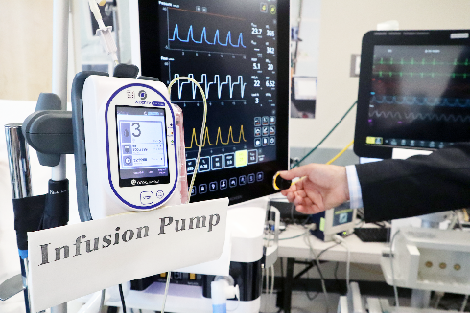








Sandbox Resources
Interoperability &
EHR Integration
Data & Machine Learning
Cybersecurity Support
These Sandboxes provide access to de-identified and / or synthetic data sets. They also provide access to subject matter experts to use the data for research, visualization, analysis, and building, training, and testing new algorithms.
These Sandboxes provide access to world class cybersecurity experts, simulated care settings, and configurable network infrastructures to conduct cybersecurity risk assessments, optimize product offerings, and develop and test solutions for vulnerabilities.
These Sandboxes connect you with subject matter experts to assess and test interoperability capabilities and perform integration testing in a virtual hospital setting. They also provide consultation and guidance to develop and test EHR integrations to reduce risks in clinical deployments.

Slide 9
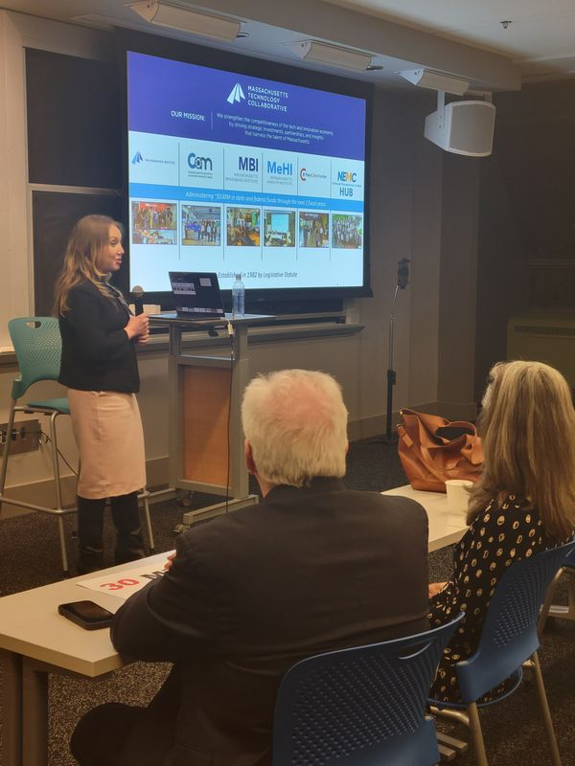
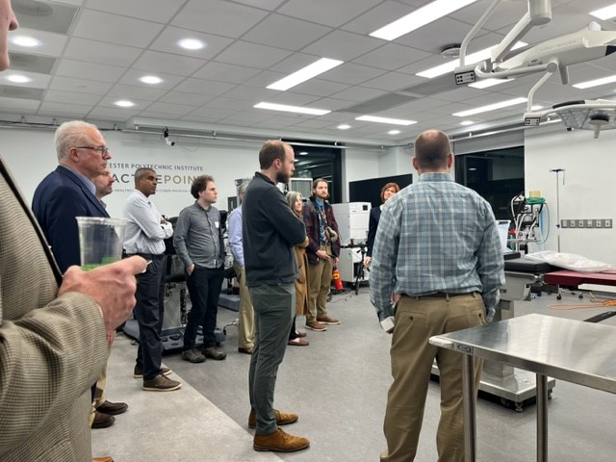

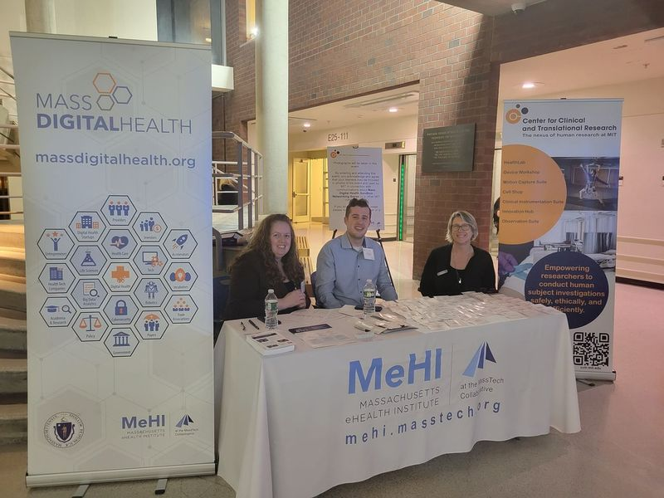
Digital Health Sandbox Networking Series
Through the Digital Health Sandbox Networking Series, MeHI co-hosts in-person events with members of the Digital Health Sandbox Network.
The goals of the Networking Series are to:
Showcase the Massachusetts Digital Health Sandbox facilities and resources;
Feature speakers on priority topics for MeHI and the Sandboxes;
Bring stakeholders in the Massachusetts digital health ecosystem together to connect, network, and explore opportunities for collaboration

Slide 10

Sandbox Challenge Program
Program Goal:
Identify and support digital health companies with solutions that address key healthcare challenges in Massachusetts
Benefits to Participating
Connect with key partners in the Massachusetts digital health ecosystem
Hear from experts about how to navigate and work with health systems and payers
Accelerate time from R&D to production
Meet with Sandboxes to understand the research and testing opportunities
Benefit from cohort learning
Be prepared for investor meetings
Opportunity
8-9 finalists selected
Virtual Introduction to Massachusetts Ecosystem through Mass Digital Health Connects workshops
Sandbox Matchmaking
Live Final Pitch Event with Expert Judges
$75,000 Sandbox projects awarded to winners

Slide 11

Mass Digital Health Connects
Three-month virtual workshop program for Sandbox Challenge finalists
Interactive sessions with presentations and Q&A with key ecosystem stakeholders
Example sessions:
Mitigating Bias and Responsibly Adopting AI
Secure Clinical Data Exchange
Introduction to Ecosystem Partners
Conversations with a VC
Cybersecurity and Legal Considerations
Navigating Health Systems
Working with Payers
MA DPH Programs for children/families
MassHealth Benefits for Pregnant Members
Examples of past participating organizations:
MassHealth​
DPH​
EOHHS
FDA​
ONC
AHRQ
NIH-NIMHD
ARPA-H​
MLSC​
.406 Ventures​
MassMEDIC​
CyberTrust MA​

Slide 12












Advancing Health Equity in Massachusetts
This challenge focused on finding digital health solutions aimed at eliminating racial, economic, and regional disparities in health outcomes through 4 distinct tracks
Maternal and Infant Health Track​
Medicaid Pilot Track
Social Drivers of Cardiometabolic Diseases Track​
AI for Health Equity Track​

Slide 13










Innovations to Support Women+ Health
This challenge is focused on finding digital health solutions that address women+ health and inequities in the key areas of cancer and cardiovascular health, maternal health, reproductive health and menopause, and mental health.
Finalists

Slide 14



Example Sandbox Grant Projects
Enabled Health with
Brigham iHub
Enabled Health
helps hospitals
improve bed availability and patient recovery at scale through virtual exercise training powered by AI. Their SaaS platform prevents traditional deconditioning from bedrest and helps reduce the need for rehab. Enabled received funding to work with the Brigham iHub to perform a clinical trial to determine the feasibility and effectiveness of their product in a hospital setting.
MiiCare with Deaconess
MiiCare uses telehealth devices, remote monitoring technology, acoustic sensing, and an AI-enabled Digital Health Coach, “Monica”, to engage and support older users . MiiCare is working with New England Deaconess to run a pilot with Deaconess residents in assisted/independent living. The pilot will examine how MiiCare can optimize care plan assessment and delivery and enhance residents’ independence and experience.
REEV with MIT CCTR
REEV is developing REEV Sense, an AI-powered motion sensor that helps stroke patients regain mobility. REEV will use their grant to work with MIT’s Center for Clinical and Translational Research to collect the gait data of 40 stroke participants to assess the clinical performance of REEV SENSE by comparing the precision of their gait biomarkers with the gold standard of the CCTR gait lab.

Slide 15
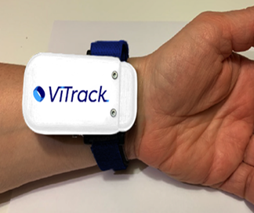


Example Sandbox Grant Projects
Dynocardia with PracticePoint at WPI
Dynocardia is developing the first stand alone,
continuous, and non-invasive blood pressure
monitor. Through one-year Startup
Membership, they used PracticePoint at WPI’s
testing and machine-shop facilities to optimize
the design of their prototype, develop a motion
capture system, and perform systems integration and testing.
Kinto with MITRE
Kinto has developed a virtual platform that offers caregiver coaching, a personalized e-learning curriculum, and peer support groups to family caregivers of dementia patients. They received funding to access MITRE’s subject matter expertise and resources to develop their platform for state MEDICAID plans and for non-dementia caregivers.
Leuko Labs with MIT IMES
Leuko Labs worked with MIT IMES to perform usability testing on their PointCheck device, a non-invasive white blood cell monitoring device to screen for severe neutropenia. MIT IMES provided a replicated home and clinical setting, assistance with subject recruitment, oversight of research visits, in house analysis of blood samples, and secure electronic research data capture and transmission.

